Slide 1
Capstone Project
Hotel Booking Analysis
Eppalapally Saiveekshith

Slide 2
Points to Discuss :
Agenda
Data summary
Hotel wise analysis
Univariate analysis
Monthly Analysis
Correlation heatmap
Conclusion

Slide 3
Agenda
To discuss the analysis of given hotel bookings data set from 2015-2017.
We’ll be doing analysis of given data set in following ways :
Hotel Wise Analysis
Univariate analysis
Month wise analysis
Scatter Plot
Heat Map
By doing this we’ll try to find out key factors driving the hotel bookings trends.

Slide 4
Data Summary
Given data set has different columns of variables crucial for hotel bookings. Some of them are:
hotel: The category of hotels, which are two resort hotel and city hotel.
is_cancelled : The value of column show the cancellation type. If the booking was cancelled or not.
Values[0,1], where 0 indicates not cancelled.
lead_time : The time between reservation and actual arrival.
stayed_in_weekend_nights: The number of weekend nights stay per reservation
stayed_in_weekday_nights: The number of weekday nights stay per reservation. meal: Meal preferences per reservation.[BB,FB,HB,SC,Undefined]
Country: The origin country of guest.

Slide 5
Data Summary(contd..)
market_segment: This column show how reservation was made and what is the purpose
of reservation. Eg, corporate means corporate trip, TA for travel agency.
distribution_channel: The medium through booking was made.[Direct,Corporate,TA/TO,undefined,GDS.]
Is_repeated_guest: Shows if the guest is who has arrived earlier or not.Values[0,1]-->0
indicates no and 1 indicated yes person is repeated guest.
days_in_waiting_list: Number of days between actual booking and transact.
customer_type: Type of customers( Transient, group, etc.)

Slide 6
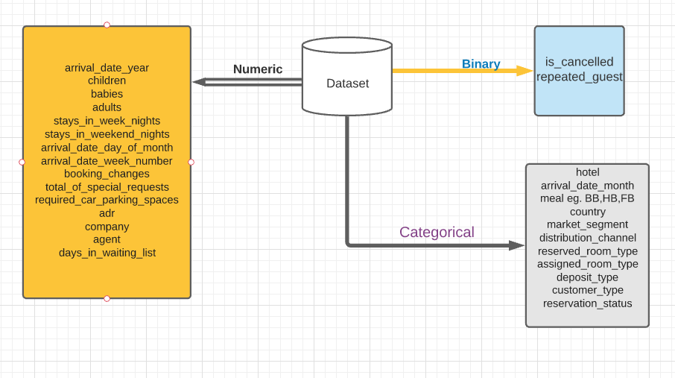
Data Summary

Slide 7
Hotel wise Analysis
While doing hotel-wise analysis of given hotel booking dataset, we answered following questions:
Percentage of bookings in each hotels?
Which hotel have more cancellations of bookings?
Which hotel make more revenue?
Which hotel have higher and how much customer returning rate?

Slide 8
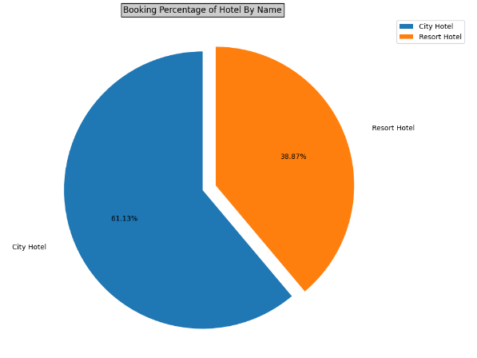
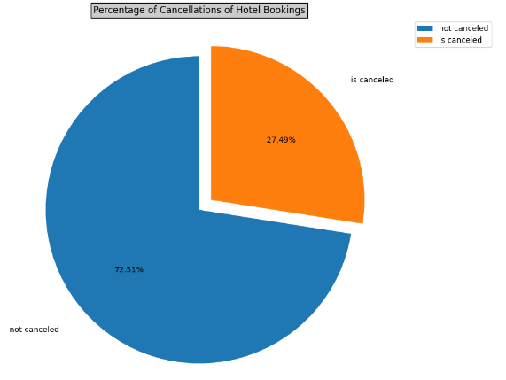
Around 61% bookings are from City hotel and 39% bookings are fromResort hotel.
Both hotels have very small percentage that customer will repeat, but Resort hotel has slightly higher repeat % than City Hotel.

Slide 9
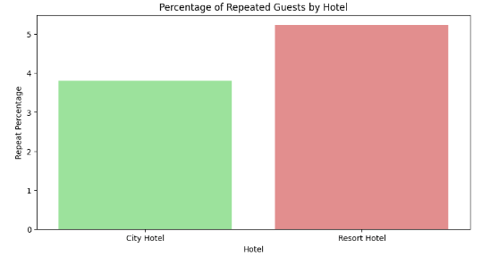
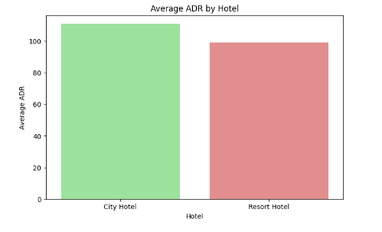
Average ADR for City Hotel is More than Resort Hotel which implies City Hotel has slightly more revenue than Resort Hotel.
There are a greater number of repeated guests in Resort Hotel than City Hotel.

Slide 10
Univariate Analysis
While doing univariate analysis of given hotel booking dataset, we answered following questions:
Most of bookings are made by which Distribution channel?
Which room type is in most demand in both the hotels?
From which country most of the customers are coming?

Slide 11
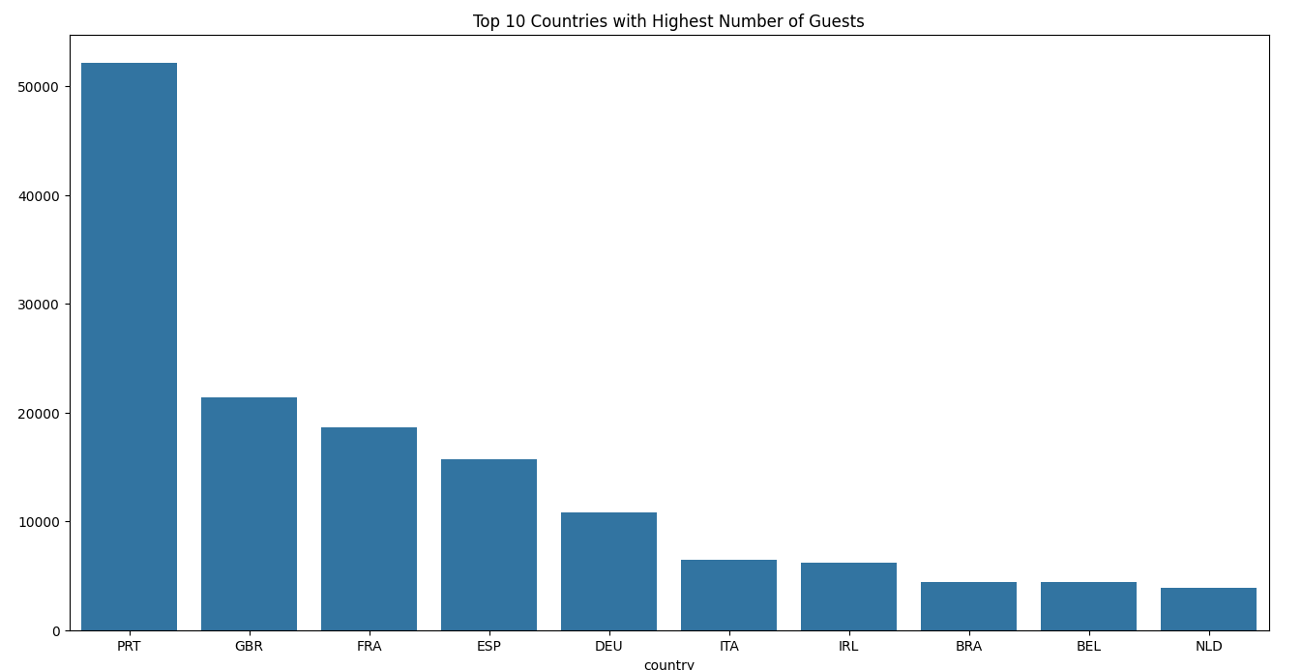
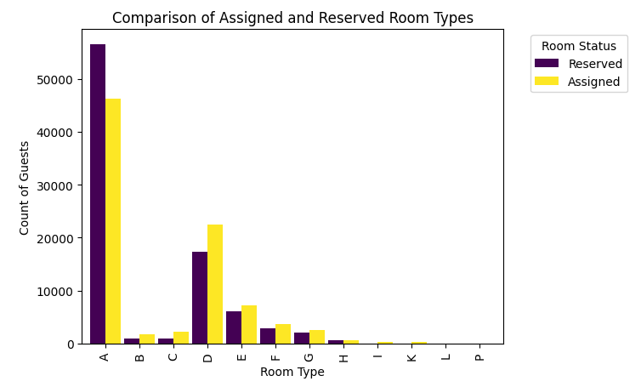
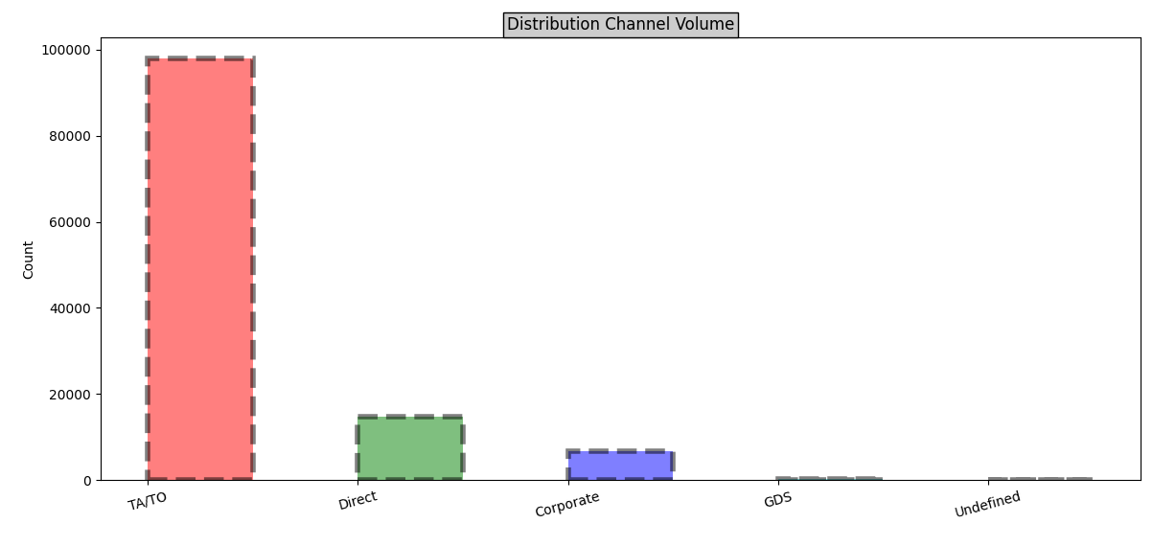
Type A room is most demanded by customers.
Most of the Guests are from Portugal
Highest number of bookings are done through the 'TA/TO'-(Tour of Agent & Tour of Operator) Booking Channel

Slide 12
Month wise Analysis
While doing Month wise analysis of given hotel booking dataset, we answered
following questions:
Which Month have the highest Average ADR?
Which Month have the highest number of Bookings?
Which Month has a greater number of cancellations?

Slide 13
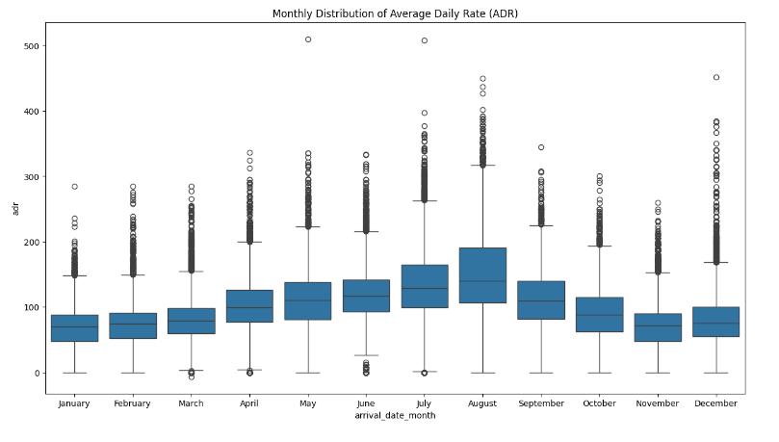
The Month of August have the greater Average daily rate.

Slide 14
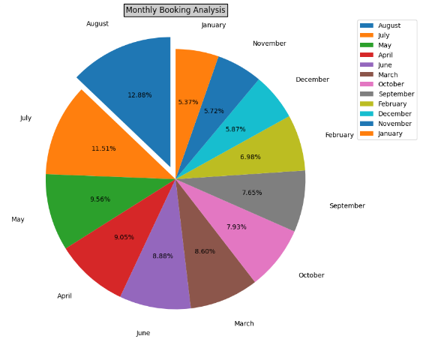
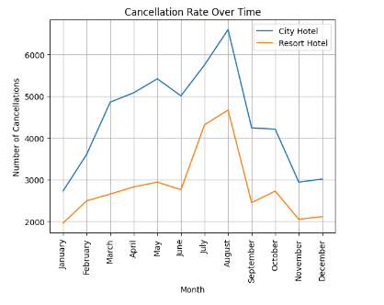
There were a greater number of bookings in the month of August.
There were a greater number of cancellations in the month of August.
Note: There are greater number of bookings and cancellations in August as it is in the duration of Vacation.

Slide 15
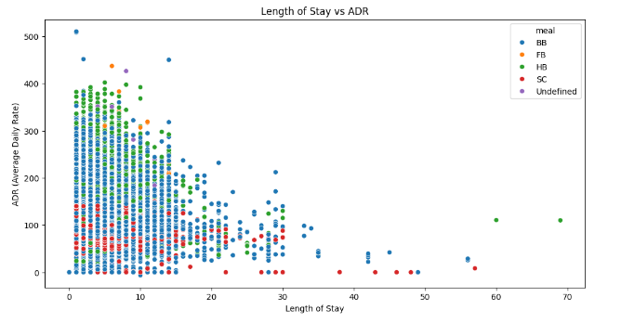
Scatter Plot Optimal stay length for better deals in adr
For shorter stays the adr(average daily rate varies greatly) but for longer stays (> 15 days) adr is comparatively very less. Therefore, customers can get better deal for longer stays more than 15 days.
Most of the customers are opting for BB Type Meal.

Slide 16
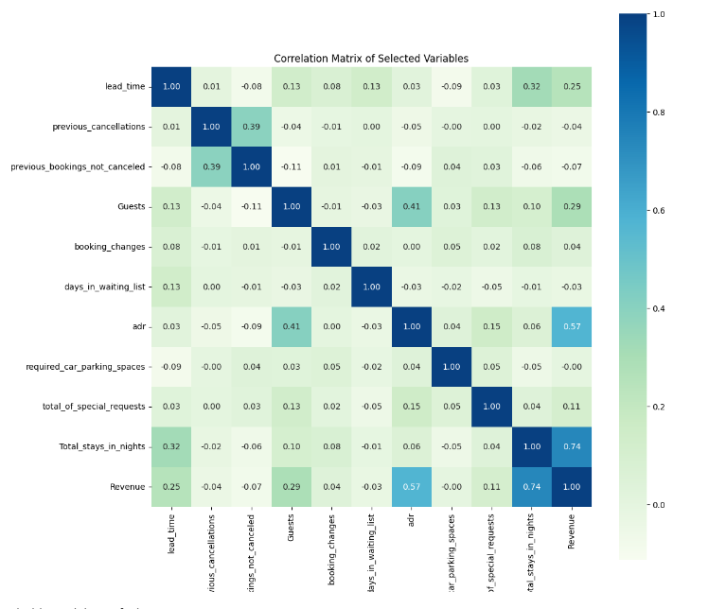
Correlation Heatmap
Total stay length and lead time are slightly correlated. This may mean that for longer hotel stays, people generally plan little before the actual arrival.
adr is slightly correlated with total_people, which makes sense as more no. of people means more service to deliver, therefore more adr.

Slide 17
Conclusion
Approximately 60% of bookings are for City hotels, making them busier than Resort hotels. Additionally, City hotels
have a slightly higher overall average daily rate (ADR) compared to Resort hotels.
Most guests stay for less than 5 days, but for longer stays, Resort hotels are preferred.
Both hotels experience high booking cancellation rates, with very few guests returning for another booking,
especially in City hotels. About 5% of guests return for stays in Resort hotels.
Most guests come from European countries, with Portugal being the most common origin.
Various booking channels are used, with the “TA/TO" channel being the preferred method. However, GDS channels bring higher ADR deals, suggesting a need for increased popularity on this channel.
Factors such as not getting the reserved room, longer lead times, and waiting times do not significantly impact
booking cancellations.
The months of July and August are the busiest and most profitable for both hotels.
Couples are the most common guests, suggesting hotels can tailor services to meet couples' needs to increase
revenue.
Bookings made via the complementary market segment and for adults tend to have a higher number of special
requests.
For customers, longer stays (more than 15 days) generally lead to better deals in terms of lower ADR.

Slide 18
Thank You

